Slide 1
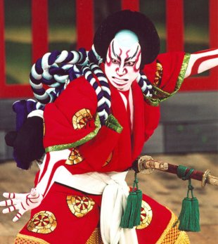
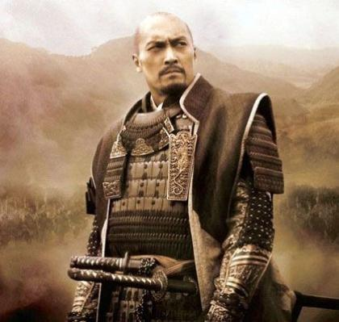
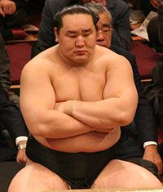
Japan: An Ancient and Modern Adventure Summer 2015
*Note – this trip is not affiliated with Moscow Middle School or the Moscow School
District. It is an independent student/parent educational opportunity.

Slide 2
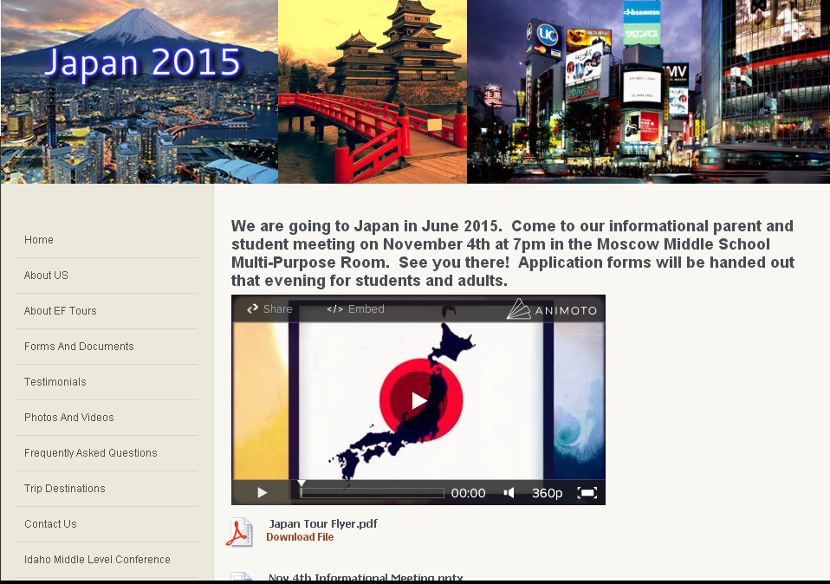
All of tonight's information
can be found at:
www.globalxpeditions.weebly.com

Slide 3
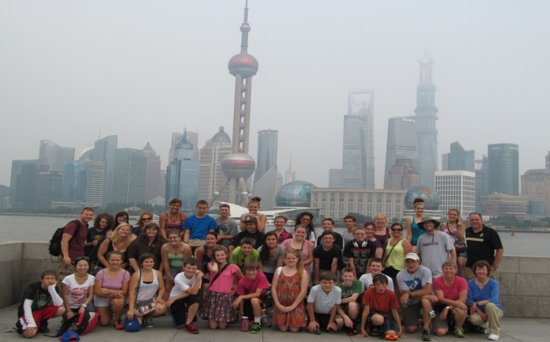
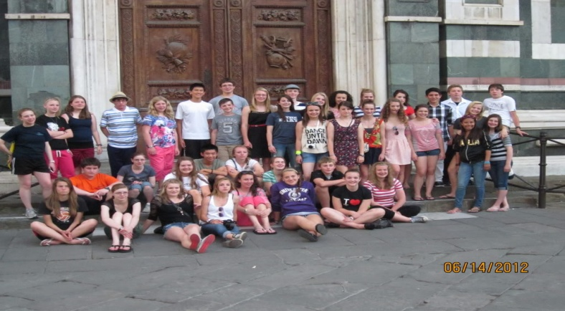
Why travel as a middle school student?
Learn and understand first-hand about people and societies around the world
A good time to bond with your child before life gets too busy with high school activities
A valuable world experience and personal growth that they can apply in their high school & college classes
Creates strong friendships that only a shared travel experience can provide
Helps students appreciate and understand where they live in a whole new light
Beijing
Shanghai
Florence

Slide 4
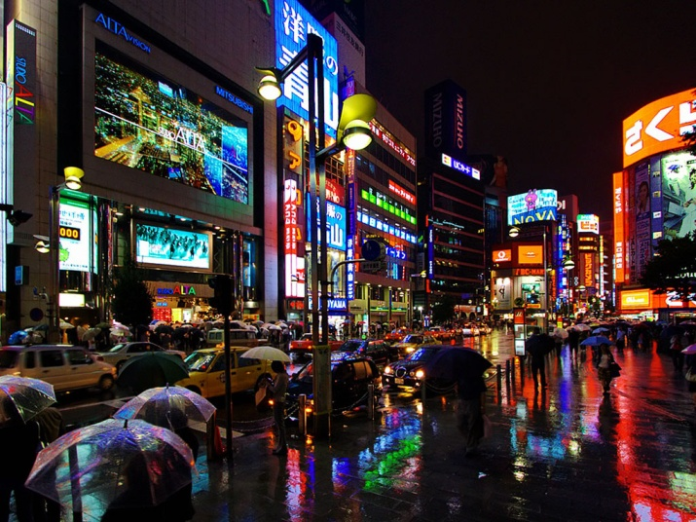
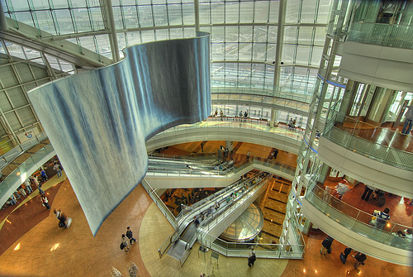
Our Trip Itinerary
Day 1 – Fly overnight to Tokyo
Day 2 – Arrive in Tokyo
Notes:
How do the free days work exactly? Especially in terms of freedom and what is allowed for student exploration (can they go out on their own or must small groups be accompanied by adults at all times). Thoughts on how this might work?

Slide 5
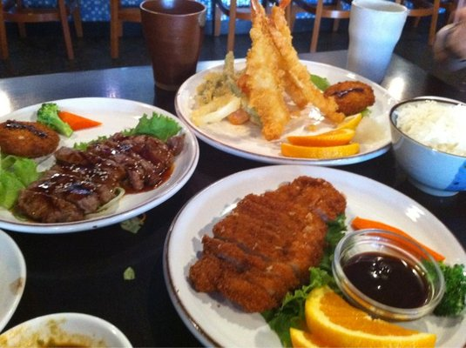
Meiji Shinto Shrine
Harajuku Shopping
District
Day 3 – Tokyo
Tour the Harajuku district
Imperial Place
Meiji Shinto Shrine
Asakusa Temple
Enjoy a Tempura Dinner
Tempura style dinner
Notes:
How do the free days work exactly? Especially in terms of freedom and what is allowed for student exploration (can they go out on their own or must small groups be accompanied by adults at all times). Thoughts on how this might work?

Slide 6
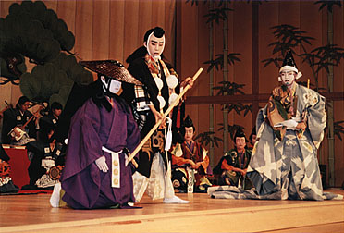
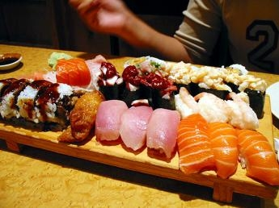
Day 4 – Tokyo
Visit the Miraikan Science Museum
Enjoy a Kabuki Theatre performance
Sushi Dinner

Slide 7
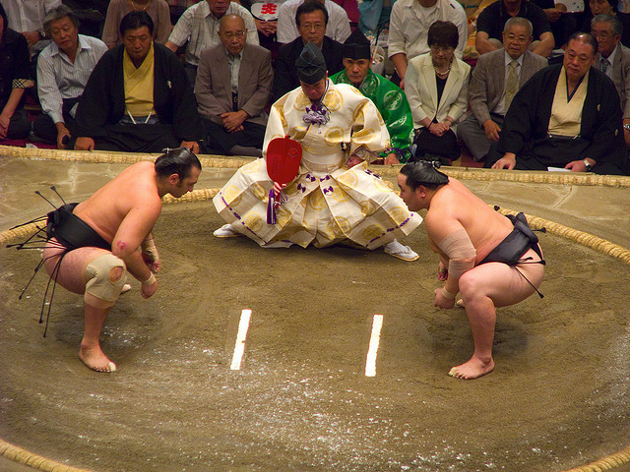
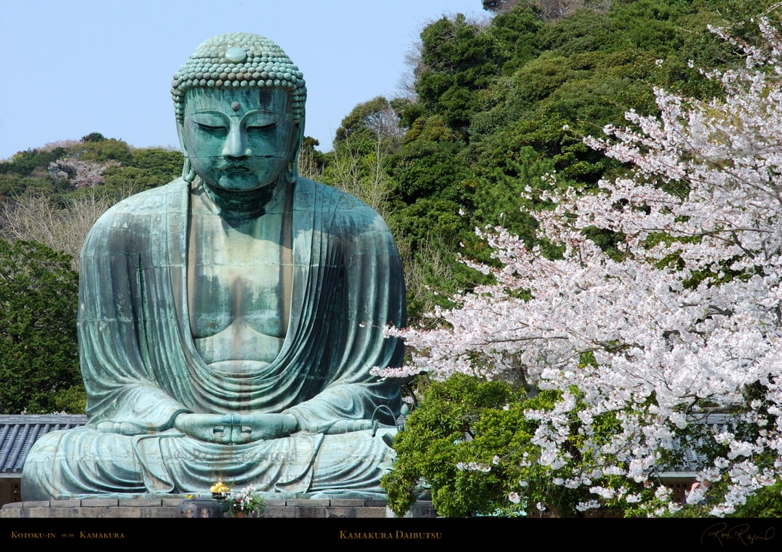
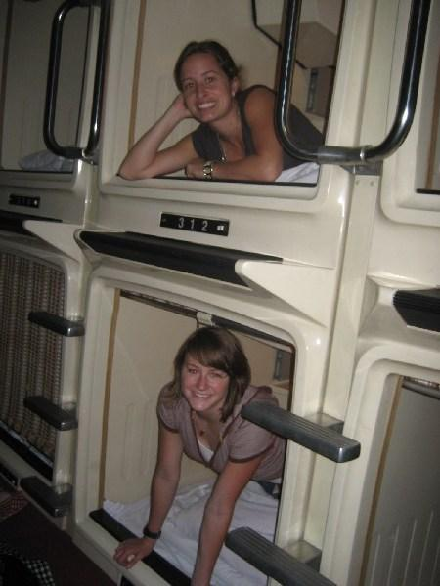
Day 5 – Tokyo
Sumo stable visit & demonstration
Kamakura excursion
Spend a night in a capsule hotel
Notes:
How do the free days work exactly? Especially in terms of freedom and what is allowed for student exploration (can they go out on their own or must small groups be accompanied by adults at all times). Thoughts on how this might work? Do we get to go into the collosseum?

Slide 8
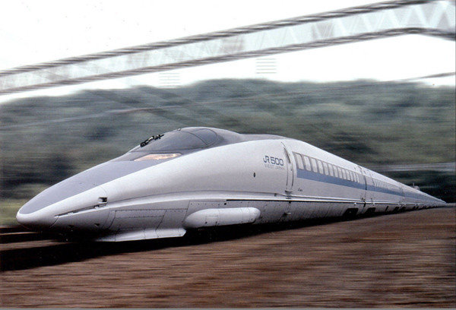
Day 6 – Kyoto
Take a bullet to Kyoto
Sobya dinner

Slide 9
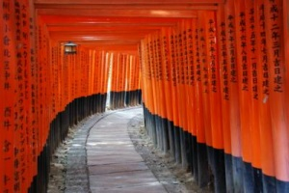
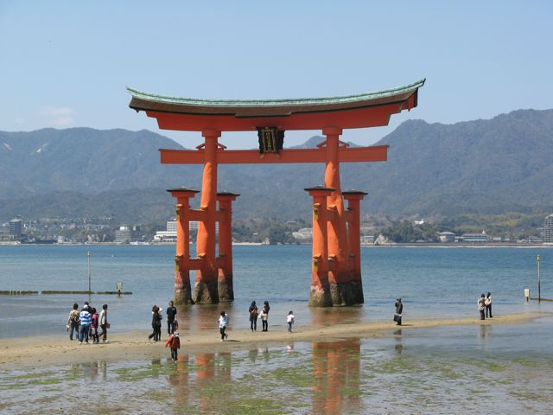
Day 7 – Kyoto
Guided sight seeing tour of Kyoto
Visit the Nijo Castle

Slide 10
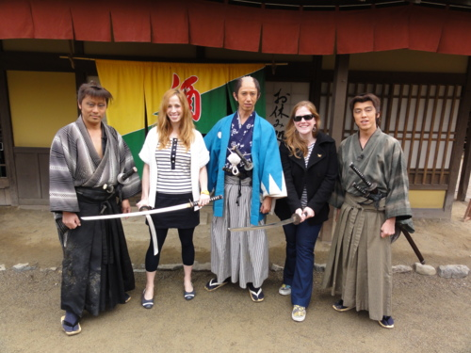
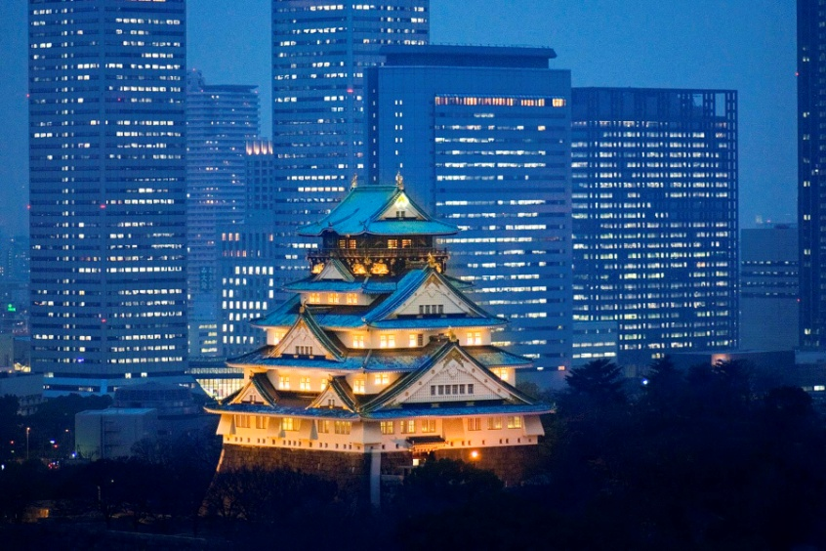
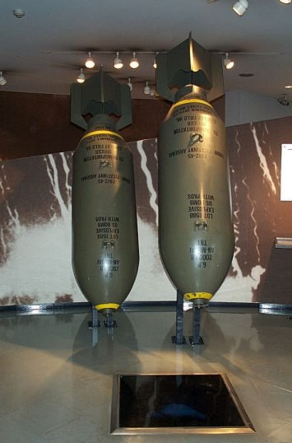
Day 8 – Kyoto/Osaka
Visit the TOEI Kyoto Studio Park for a samurai sword lesson
Have an Okonomiyaki dinner
Visit the Osaka Peace Museum

Slide 11
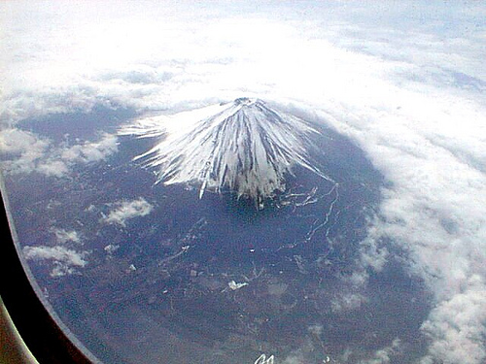
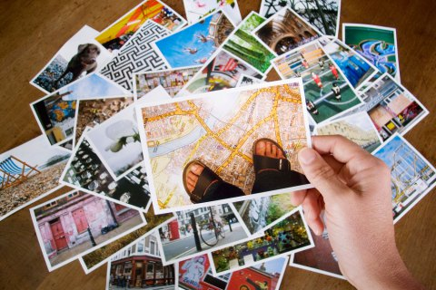
Day 9 – Heading Home

Slide 12
Trip Leaders: Jason Albrecht, Matthew Haley, Stacy Albrecht,
and Daniel Haley
Student Applicants – Trip focus
Adult Applicants – Supporting role

Slide 13
Create a unique learning opportunity …
this is more than just a trip!
Pre and post trip meetings – 85% attendance required
Informational meetings including history, culture, travel tips and more
Ropes course team building activities
Travel preparation: passports, luggage, what to expect, etc.

Slide 14
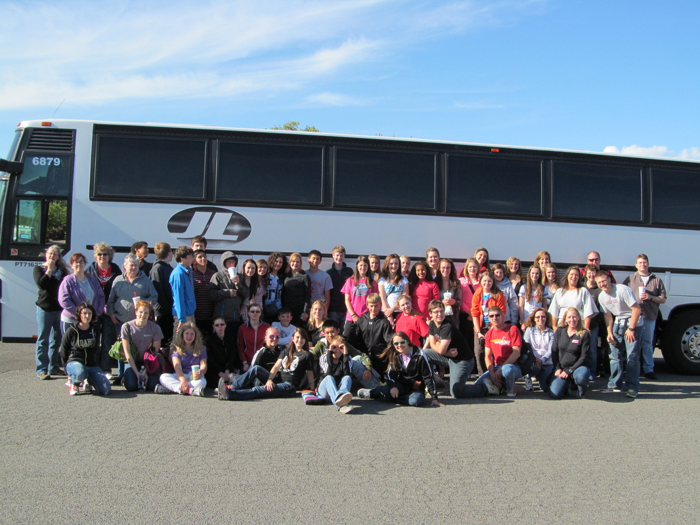
Number of trip participants
Trip Leaders………………….4 filled positions
Student Applicants…………..32 slots available
Adult Applicants……………...9 slots available
Trip total = 44 travelers

Slide 15
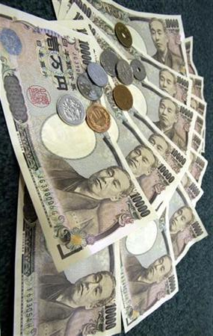
Student Cost = $4,399 Est. $248/mo.
Adult Cost = $4,734 Est. $270/mo.
Project Cost Breakdown/Summary
Enrollment Fee (non-refundable) This fee is waived IF you have traveled with us before | $95
Program Fee | $4501
Group Gratuity Fees | $58
All Inclusive Travel Insurance (recommended) | $145
Adult Supplement | $335
Early Enrollment Discount by Dec. 6th | - $200
EF Additional Adjustment | -$100
Monthly Auto pay Discount | -$100
Due to the higher cost of this opportunity we will run FIVE all group fundraisers
Notes:
Is the enrollment fee only paid after the student/adult is ACCEPTED? May want to clarify that $95 is returned if student is not selected to go on the trip (if this is the case).
Also, maybe a break-down of what the program fee might include (e.g. airfare, hotel, meals, etc.)

Slide 16
Monthly Payment Plan Benefits
Automatic deduction from your checking account each month. Approximately $248/month for students and $270/month for adults.
No late fees
$100 discount with EF (as shown
on the previous page)
Final payment deadline up to
25 days prior to departure
Other payment options are available

Slide 17
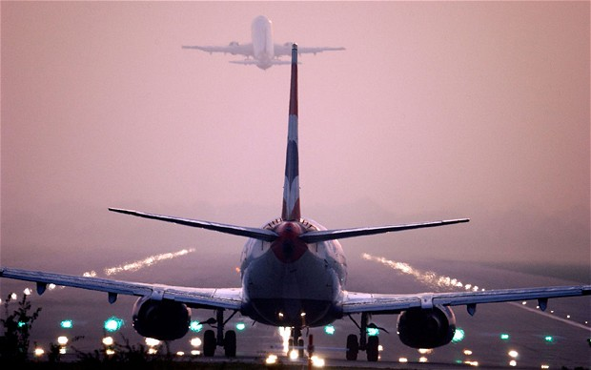
What is included?
Round trip airfare from Spokane
Lodging in Hotels
Students: 2 to 5 per room depending on location
Adults: 2 per room
Transportation throughout the trip
EF tour director to guide us on the ground
Breakfast and dinner daily
Guided sightseeing/walking tours
Entrance fees to selected attractions

Slide 18
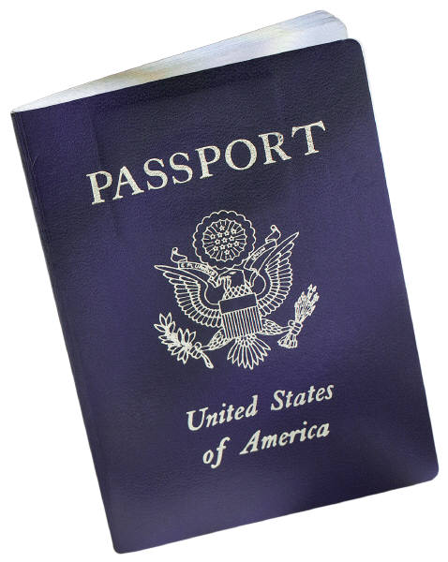
What is not included?
$40 for two pre-trip team building activities at Paradise Ridge Ropes Course
Lunches, beverages, and snacks throughout the day
Passport fees
Souvenirs
Additional airline baggage fees
Phone calls and/or internet café access
Travel to and from Spokane
We recommend $500 for additional expenses.
Notes:
Do either of you know much about the meals that ARE included? For instance, are people allowed to order or pick their dinner from the restaurants menu, or are they restricted to say 3 options and must pick one of those? I guess I am wondering the flexibility there or is the food itself already pre-selected by EF?

Slide 19
Fundraisers
Group Fundraisers
We will help with FIVE group fundraisers
Valentines chocolate sale
Mother’s Day candles
June car wash
September Krispy Kreme's
December holiday sales
Individual Fundraisers
All additional fundraising will be done on your own or in groups of your choosing.
Ideas/examples (see our website)
Odd Jobs for travel
Babysitting

Slide 20
Application process
Four Steps
Complete an application and return it to one of the trip leaders ASAP (see application due date on top of the application – Thursday, November 14th).
Wait for a confirmation email from the trip leaders on Saturday, November 16th.
Once your application is accepted, complete the online instructions to enroll and pay your non-refundable $95 fee (this must be completed by midnight, Thursday, November 21st).
Attend all group meetings.

Slide 21
Selection Process
Selection criteria are as follows:
Completeness and professionalism of application
Strength of application answers
Teacher recommendations
Probability of success while abroad

Slide 22
Can adults/parents go?
Yes, applications are available tonight.
Can a younger or older sibling go?
This trip is for current 5th to 8th grade students only.
When will this trip depart and return?
We typically leave the week after school gets out in June. Our official dates are released three months prior to departure.
Can a relative go on the trip?
They must complete an adult application and meet the age requirements of 21.
What if I cannot pay the full trip cost?
Once you commit to this trip you are obligated to pay your way.
There are penalties for early withdrawal.

Slide 23
Dietary options?
EF does have different meal options depending on individual needs.
Medications while abroad?
Students are responsible for all needed medications (please notify trip leaders of ANY medical issues prior to the trip).

Slide 24
Participant Selection Timeline
November 4th – Parent meeting and applications are out
November 14th – Applications are DUE and will be reviewed by the trip leaders
November 16th – Acceptance letters are sent out electronically
November 21st – Accepted travelers must be enrolled online with EF and have paid the non-refundable $95 fee.
November 22nd – Accepted applicants
who are not enrolled will lose their spot
to an alternate

Slide 25
Questions, Comments, Freaking Outs?
Any group relevant questions?
All group leaders are available for additional questions after this presentation.
This PowerPoint and more information can be found at our website: www.globalxpeditions.weebly.com

