Slide 1
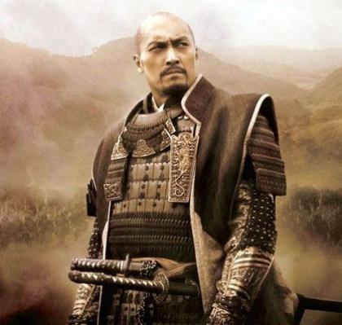
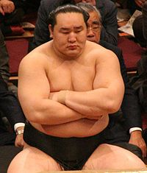
Japan: An Ancient and Modern Adventure
Summer 2015
Jason Albrecht and Matthew Haley, in conjunction with EF educational tours, would like to inform you about an upcoming educational travel opportunity to Japan in the summer of 2015. This opportunity is available for current 6th - 8th grade students in Moscow and the surrounding communities, as well as their parents or adult relatives. Requirements for the trip will include pre- and post-trip team building opportunities and learning about past and present Japanese culture, language, and customs.
NOVEMBER 4th at 7pm in the Moscow Middle School Multi-Purpose room, we will present information about the trip, dates/itinerary, trip requirements, cost and payment options, fundraising opportunities, and we will answer any questions that may arise. We are very excited about this travel opportunity and hope you will consider attending our informational meeting.
Trip Information:
Cost for Students: $4,399; Cost for Adults: $4,734 (Monthly payment plans are available; we are dedicated to helping you earn this trip and we will provide five all group fundraisers)
Length of Trip: 9 days in Japan, visiting Tokyo, Kamakura, Kyoto, and Osaka
Estimated Number of Participants: 45 travelers including advisors and parents
If you have specific questions or need additional information please visit us at www.globalxpeditions.weebly.com.
Note: this trip is not affiliated with Moscow Middle School or the Moscow School District. It is an independent student/parent educational opportunity.

Slide 2
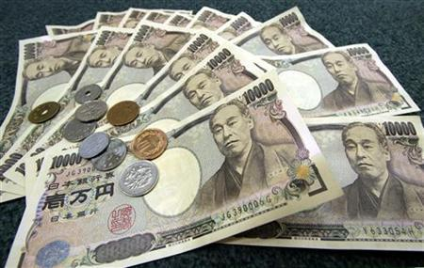
Student Cost = $4,399 (Est. $248/month)
Adult Cost = $4,734 (Est. $270/month)
Project Cost Breakdown/Summary
Enrollment Fee (non-refundable) This fee is waived IF you have traveled with us before. | $95
Program Fee | $4,501
Group Gratuity Fees | $58
All Inclusive Travel Insurance | $145
Adult Supplement | $335
Early Enrollment Discount by Dec. 6th | - $200
EF Additional Adjustment | -$100
Monthly Auto-Pay Discount | -$100
Due to the higher cost of this opportunity, we will run FIVE all group fundraisers
to help you earn your way to this adventure-of-a-lifetime!
Notes:
Is the enrollment fee only paid after the student/adult is ACCEPTED? May want to clarify that $95 is returned if student is not selected to go on the trip (if this is the case).
Also, maybe a break-down of what the program fee might include (e.g. airfare, hotel, meals, etc.)

